Slide 1


Slide 2

Interpretable Predictive Maintenance for SCANIA Trucks
Group No: 28
Muhammad Umair A.B.
Course Professor:
Shahrooz Abghari
Veselka Boeva

Slide 3
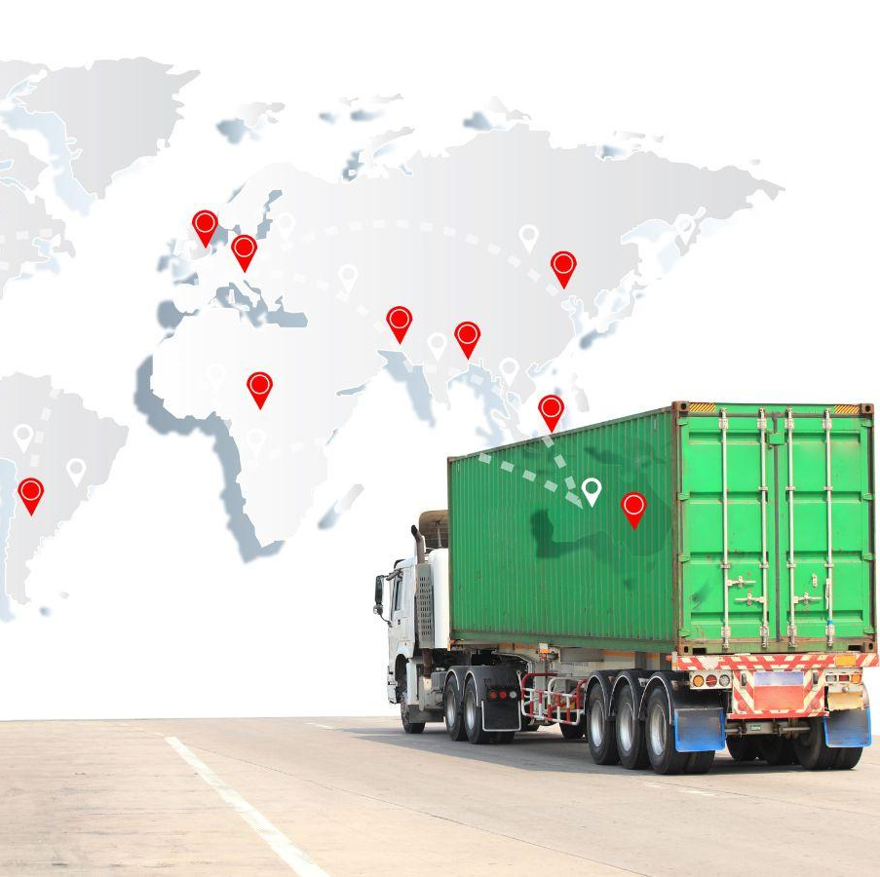
Introduction
Traditional: Reactive Maintenance (Fix it when it breaks).
Modern: Predictive Maintenance (Fix it before it breaks).
Key Challenge: Current methods use Deep Learning (LSTMs/Transformers).
Issue: “Black Boxes” → Low trust among domain experts.

Slide 4

Research Question
Can classical algorithms effectively mine predictive failure patterns from complex sensor data to provide an interpretable alternative to Deep Learning for truck failure predictions?

Slide 5
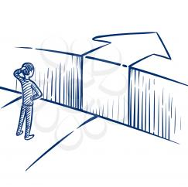
Dataset & Challenges
Dataset: SCANIA Component X (2025)
1.12M time-step observations
107 sensor columns
Null values → ffil imputation + dummies
Extreme class imbalance (2.8% failures in test set) → SMOTE
Multi-class → binary classification
Cumulative counters → temporal features
High dimensionality (1,770 features) → Feature selection
5

Slide 6

Results: ML vs. Deep Learning
For the DL baseline → 2-layer LSTM.
This directly answers the research question: YES, classical ML can replace DL here!
Model | Recall | Precision | F1 | ROC-AUC
XGBoost | 0.648 | 0.049 | 0.091 | 0.702
Random Forest | 0.669 | 0.050 | 0.090 | 0.654
LSTM | 0.479 | 0.057 | 0.096 | 0.626
Logistic Reg. | 0.310 | 0.041 | 0.075 | 0.613

Slide 7
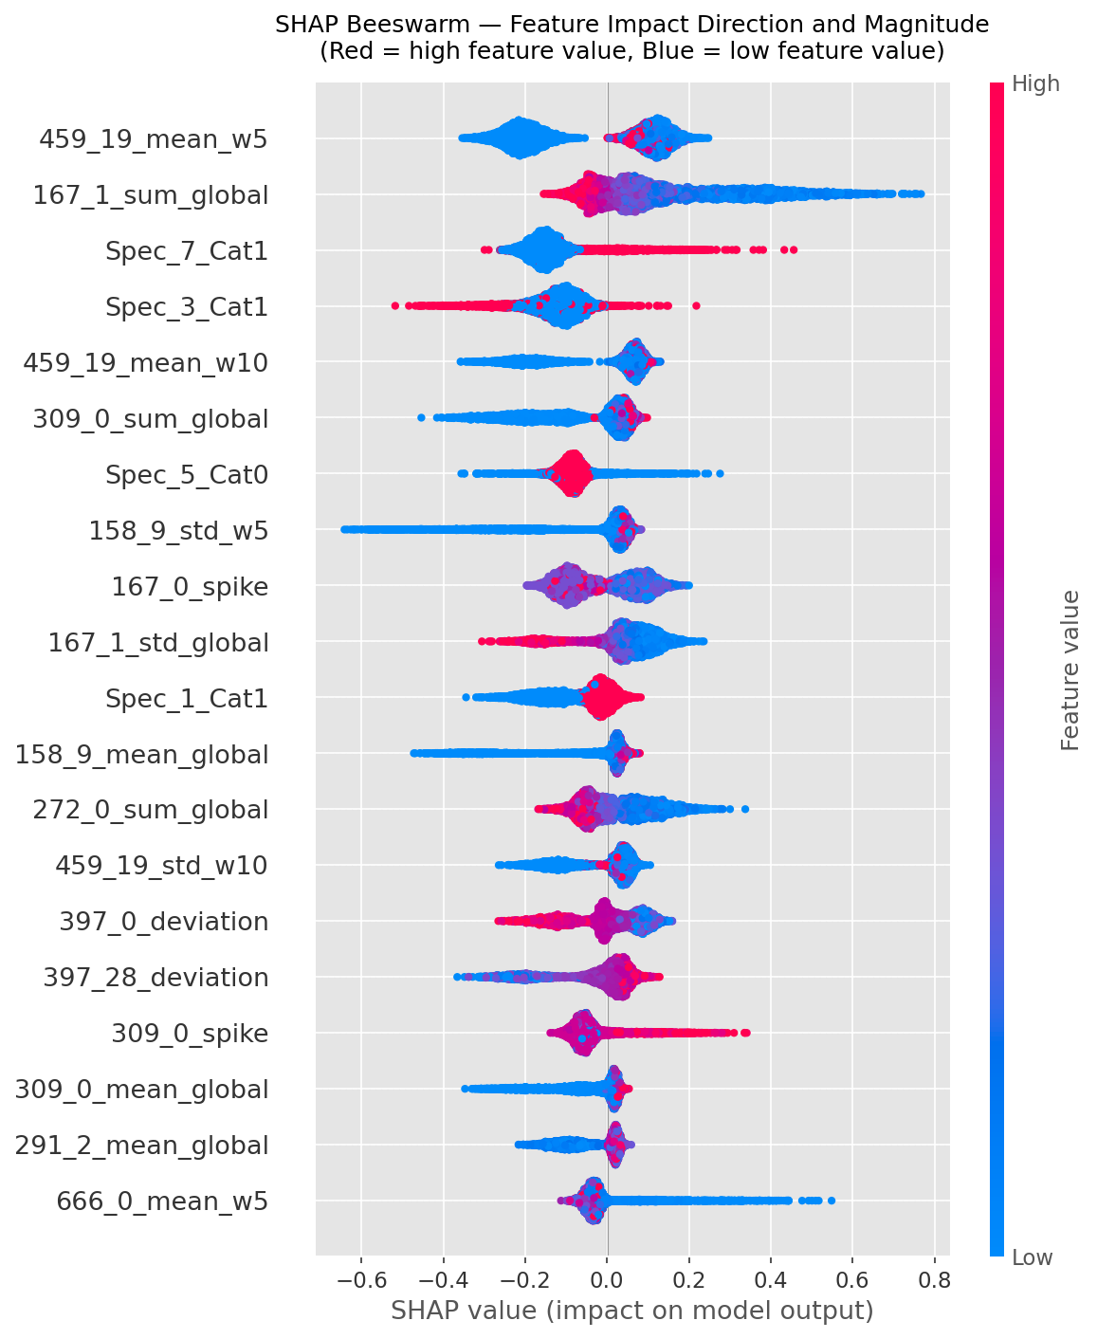
SHAP Analysis

Slide 8

Questions & Discussion
Thank You

